Slide 1
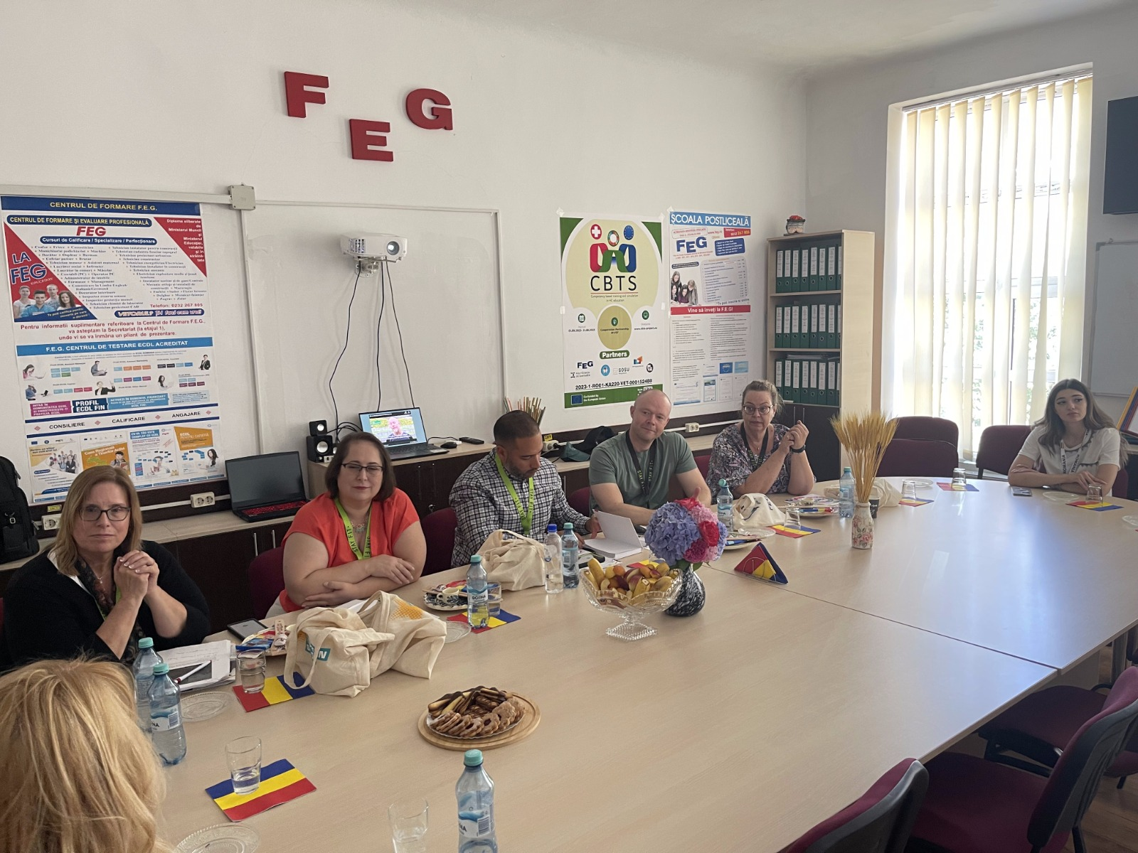
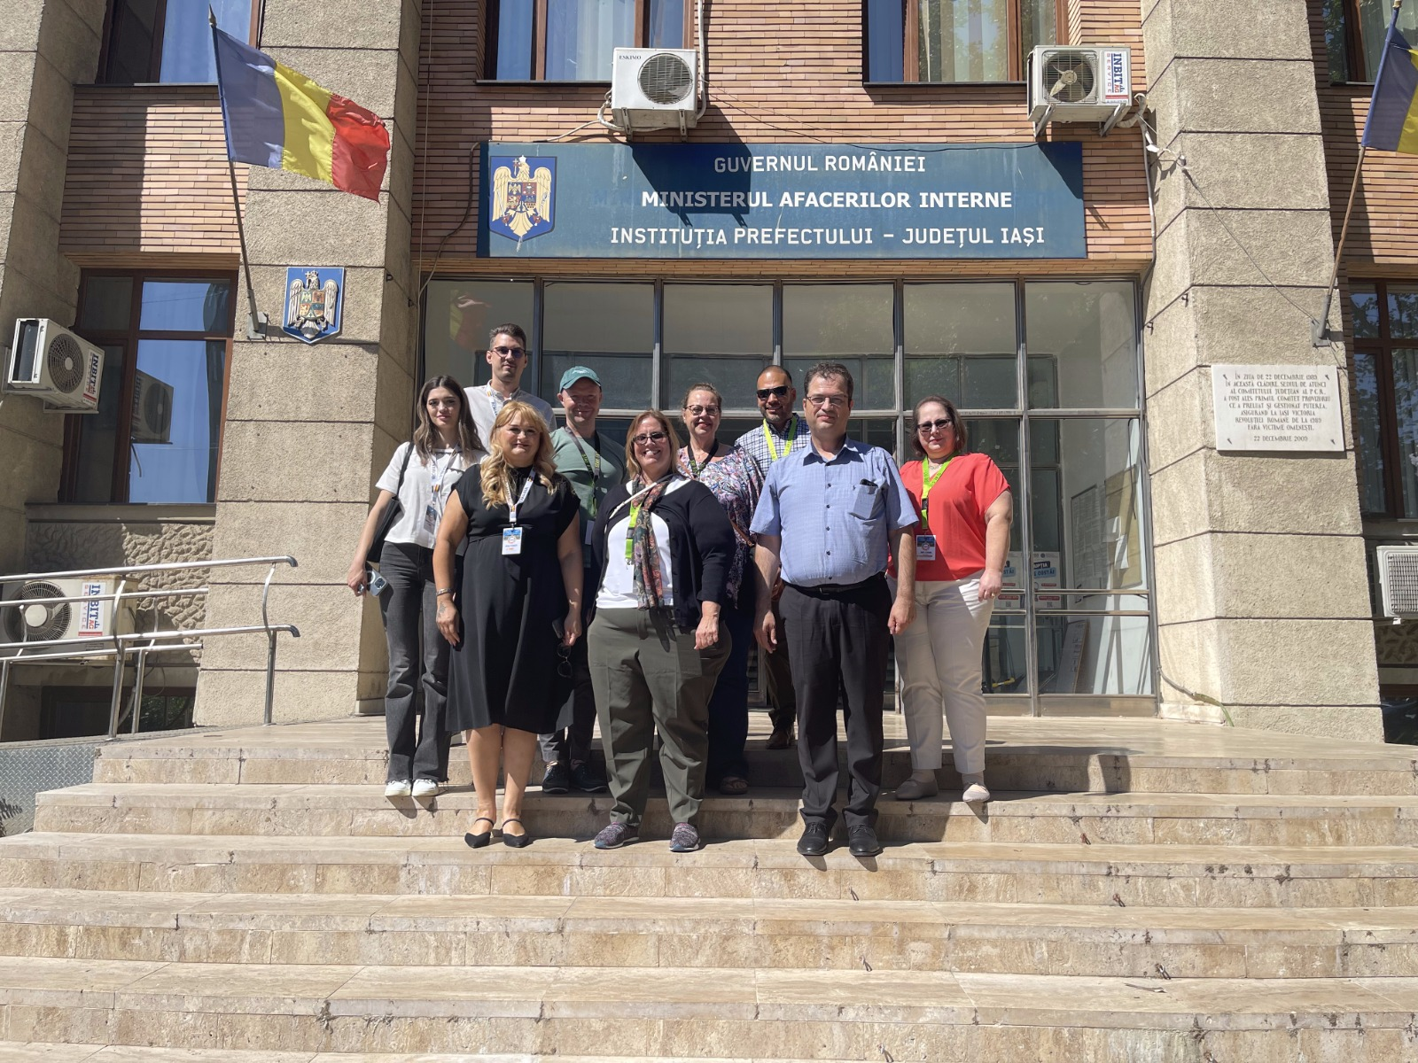
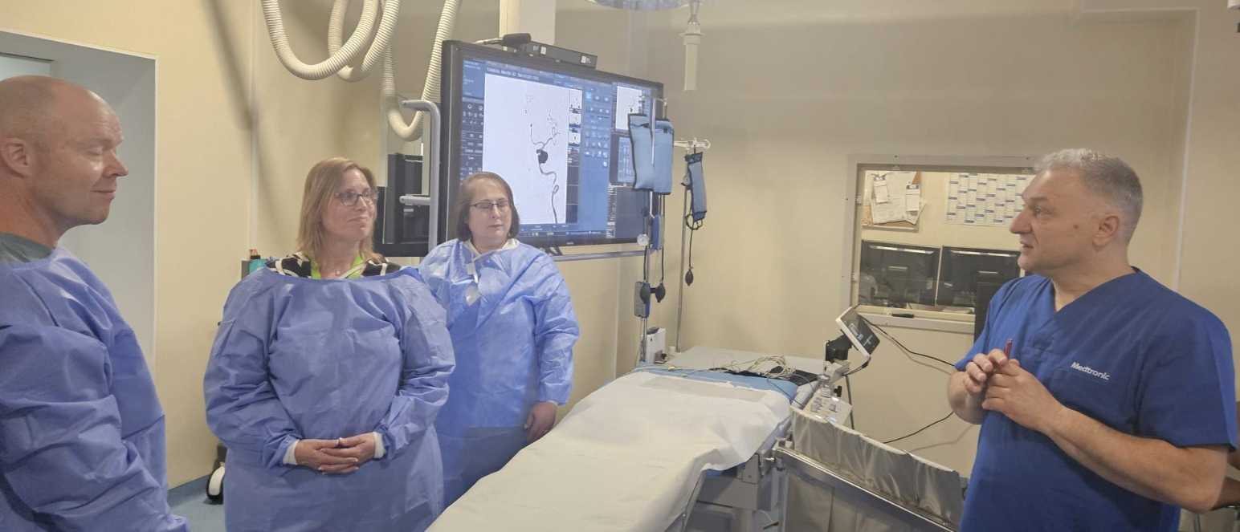
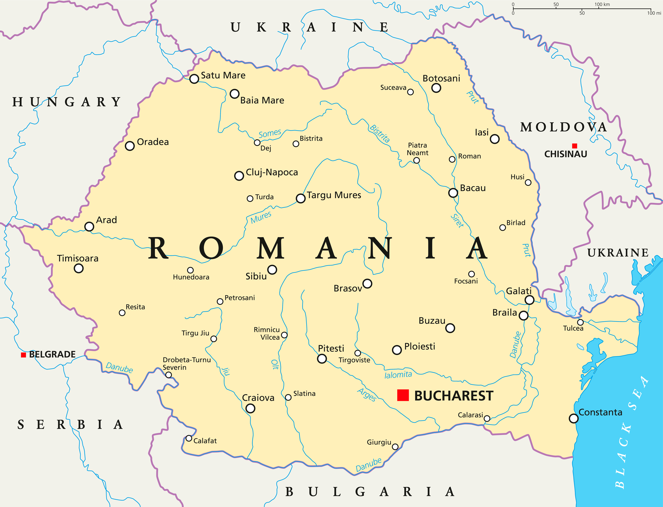
Enhancing simulation practices globally
through strategic partnerships
Melissa A. Culp, DNP, MSN/Ed., RN, CHSE and June Llerena, Ph.D., MSN/Ed., RN, CHSE-A
University of Tampa, Nursing Department, Nursing Skills and Simulation Lab
Abstract
Discussion
Simulation plays a crucial role in healthcare practice and education (Diaz-Navarro et al., 2024). Simulation has been shown to reduce education inequities, leading to reductions in mortality and morbidity in low resource areas (Diaz-Navarro et al., 2024). According to HSSOBP standards, simulation-based education (SBE), training, and professional development opportunities are a necessity to decrease inequities in access to simulation education and practical application of simulation methodologies.
To accomplish increased access to simulation methodologies it would require an all-encompassing approach involving business acumen, technical knowledge, and highly qualified simulation personnel to support and deliver SBE (INACSL Standards Committee, Charnetski & Jarvil, 2021). In Romania, and other schools throughout the European Union (EU), there are limited access to simulation professionals and other mentors to assist healthcare educators explore simulation modalities through professional development workshops and mentorship.
In the Fall of 2023, we began researching simulation literature regarding international collaborative and strategic partnerships. There were no current articles found on any of these subjects as it related to a mentoring relationship regarding simulation modalities. We selected team members that had a wide range of experience in simulation military simulation, simulation curriculum development, and simulation operations and wrote a proposal highlighting the benefits to both FEG and the University of Tampa. The proposal was approved and in July 2024, three members of our team traveled to Romania for ten days to perform a needs assessment, identify simulation champions, determine basic simulation curriculum needs, and to seek ways that a sustainable strategic partnership could be formed.
While in Romania, program directors from Denmark at SOSU Aarhus Post Secondary School joined us adding to the discussion. During our conversations, we learned that the faculty had very limited simulation experience, but all were willing to learn. Samples of simulations that each school performed were shared during one of the meetings and we found that simulation modalities were in use in FEG and SOSU schools. Both schools utilized standardized patient actors (student/faculty) to simulate a basic scenario and conducted a debriefing session after each encounter. Additionally, both programs used static mannikins or task trainers for skills practice.
UT Sim Team meeting with FEG and SOSO leaders at FEG Headquarters
Background
According to HSSOBP simulation-based education (SBE), has been shown to reduce educational inequalities, leading to reductions in mortality and morbidity in low resource areas (INACSL Standards Committee, Charnetski & Jarvil, 2021). Fundatia Ecological Green (FEG) Post Secondary School located in Iasi, Romania offers students a variety of healthcare related degrees in their Vocational Education Training programs. There are no simulation centers or knowledgeable simulation educators in the surrounding areas around FEG.
To increase knowledge regarding simulation-based education methods, FEG has focused on creating basic simulation education materials and definitions through EU Erasmus program grants and have formed a small cadre of schools who want to increase their understanding and usage of simulation modalities. To develop their simulation program FEG visited the United States in Spring 2023. During their visit we discussed the need for simulation healthcare education consultants to assist them as they begin to explore simulation modalities that would benefit their students. Together we began to explore methods and seek out means to create a strategic partnership that would allow us to assist them in their growth in the field of simulation.
Goal
Our overall goal was to assist in the creation of simulation programs with foundational simulation professional development, simulation curricula, and sustainable operations as viewed through the lens of a creative collaborative mentorship.
Top Photo: Meeting with Prefect with FEG and SOSU at the Municipality Office
Bottom Photo: Meeting with the Head Of Neurosurgery at St. Spiridon Institute
Conclusion
Implications
The formation of strategic partnerships and mentorship is one method to increase simulation equity, access and increased patient safety worldwide. Strategic partnerships also can create methods to enhance professional development and international collaboration in our global society.
In discussions with FEG leadership, the Prefect for the Municipality of Iasi and local hospital representatives, where we learned that nurses in Romania often leave the country post graduation due to economic conditions and better pay in other EU countries. There are also very few avenues for advance training for nurses despite the local hospital need for more advanced nursing skills. This creates a lack of ongoing professional training has a direct impact on quality of patient care in the region. Simulation-based education could provide a tangible avenue for meeting ongoing educational needs for countries that face these kinds of challenges.
Contact Information
Melissa A. Culp mculp@ut.edu
June Llerena jllerena@ut.edu
Acknowledgements
University of Tampa, Tampa, Florida, United States of America
Fundatia Ecological Green (FEG) Post Secondary School, Iasi, Romania
SOSU Ostjylland, Aarhus, Denmark
References
Map of Romania
Available upon request

